Slide 1
DAMG 7370 Youtube Data Analysis
Group 2

Slide 2
Data introduction
This dataset contains daily records of up to 200 trending YouTube videos across multiple countries (US, GB, DE, CA, FR) over several months. It is a structurally improved version of the original dataset.
We focus on Canadian dataset
CSV file: video_id, video_date, title, channel, category_id, views, likes, dislikes, etc
JSON file: links category_id and category_name

Slide 3








Architecture
Bronze
Gold
Silver

Slide 4
YouTube Trending Analysis — Canada
Full Data Pipeline & Visual Insights
Group 2 Lirui Liu

Slide 5
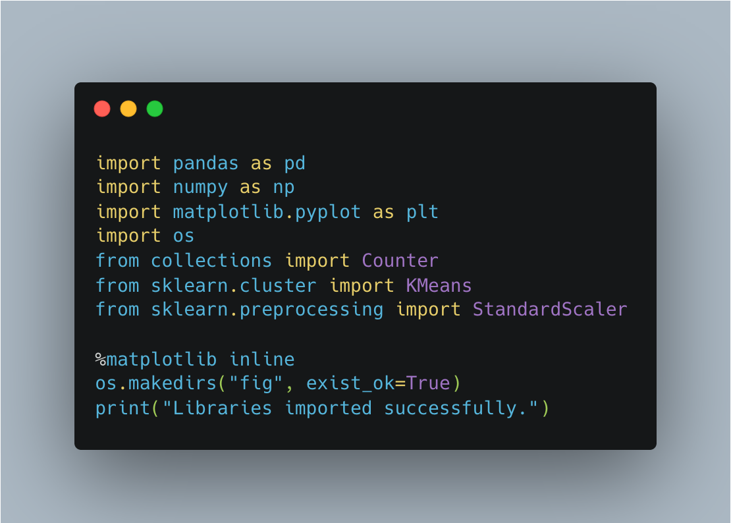
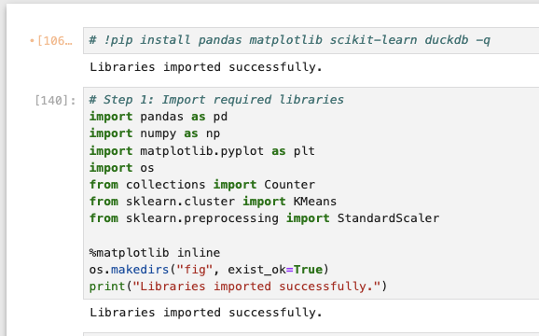
Step 1 — Import Libraries

Slide 6
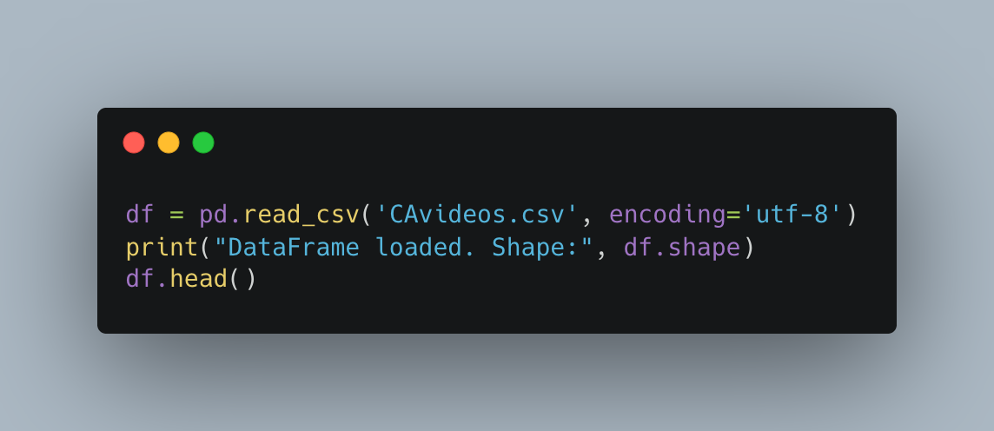
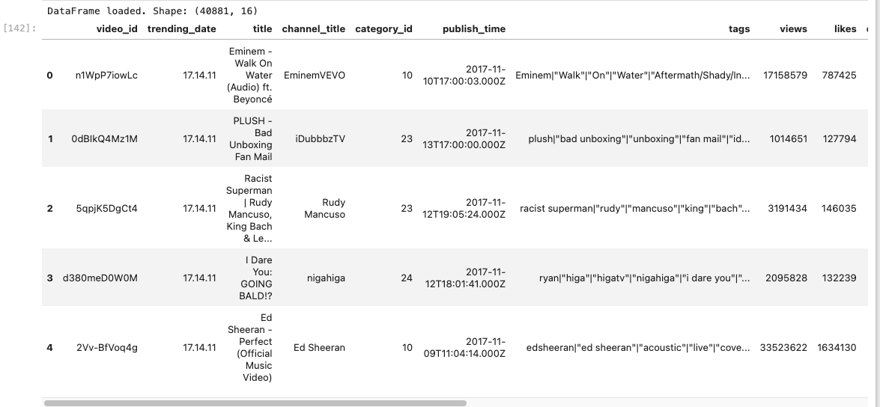
Step 2 — Load Dataset

Slide 7
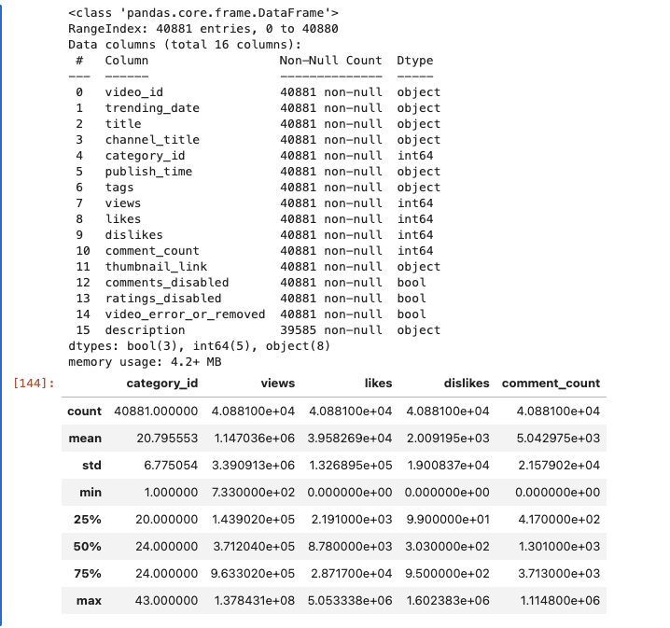

Step 3 — Data Overview

Slide 8
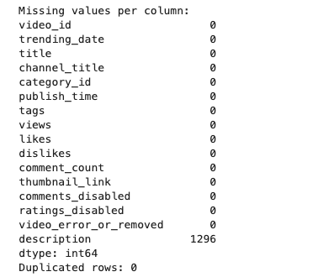
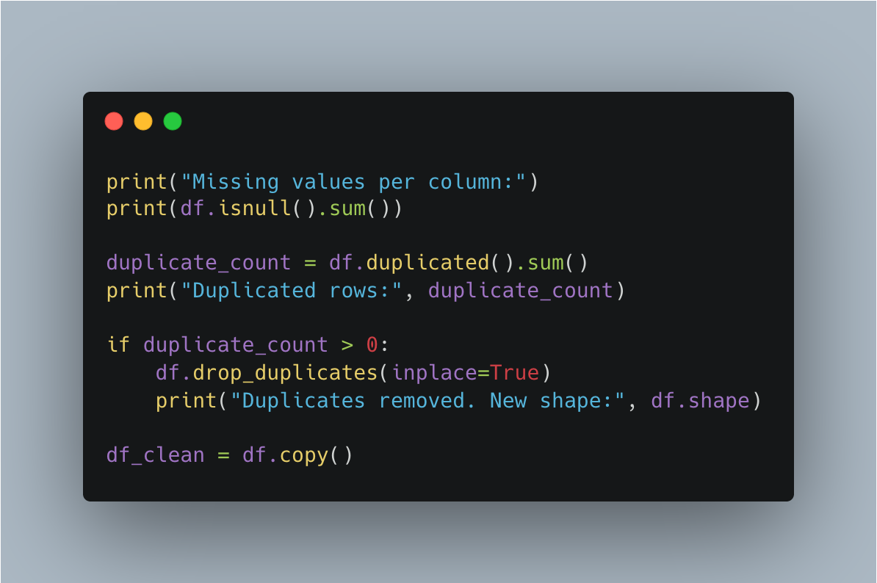
Step 4 — Cleaning

Slide 9
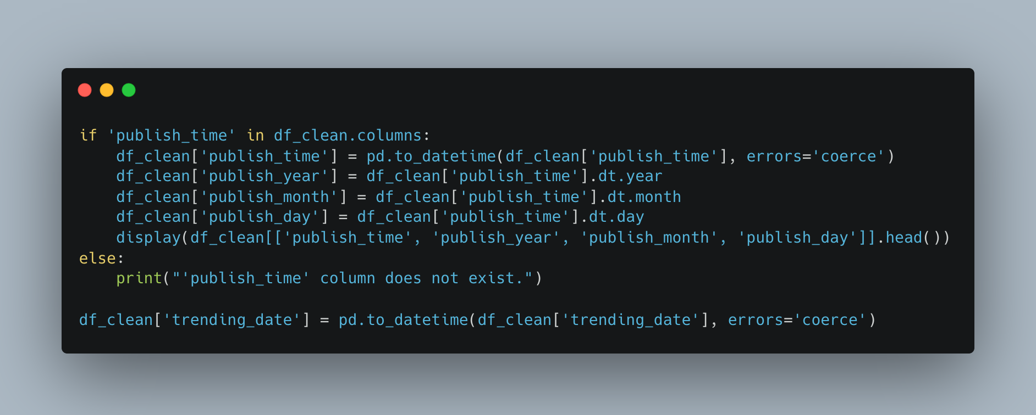
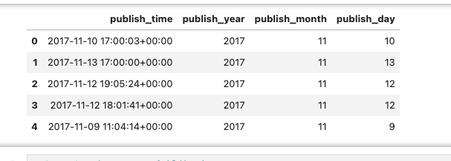
Step 5 — Datetime Conversion

Slide 10
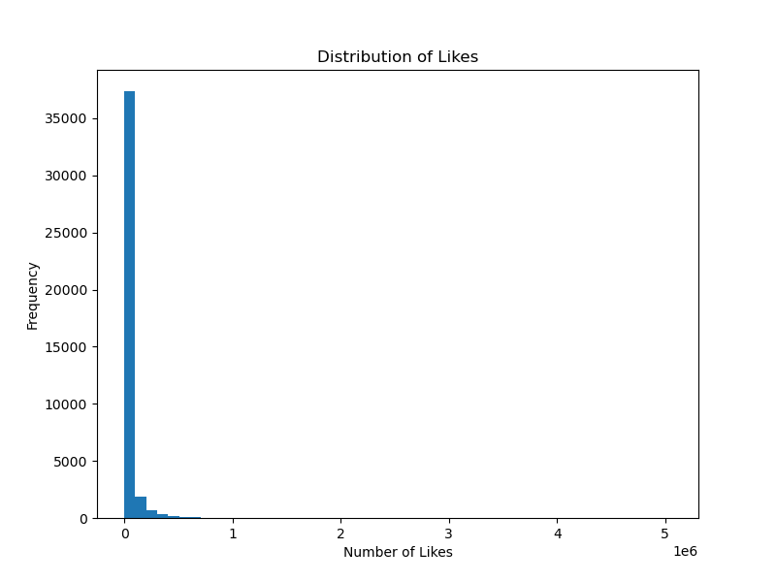
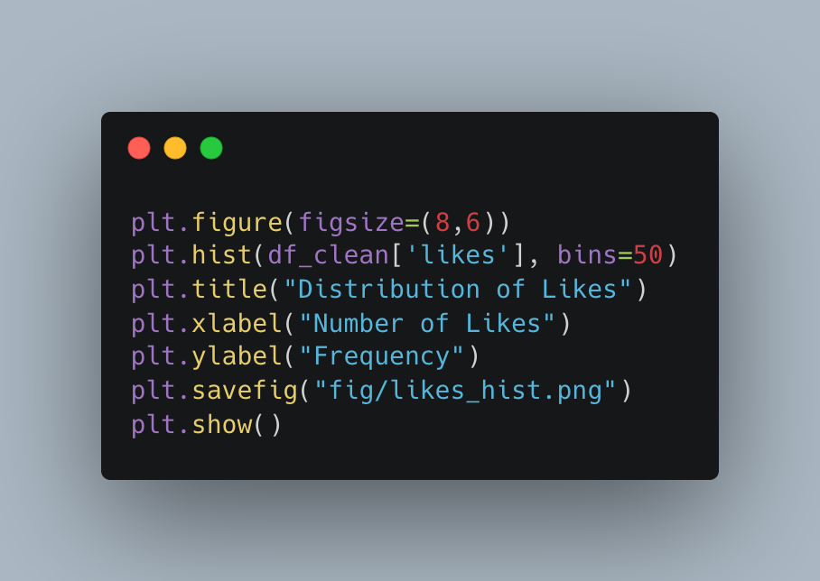
Step 6 — Likes Histogram

Slide 11
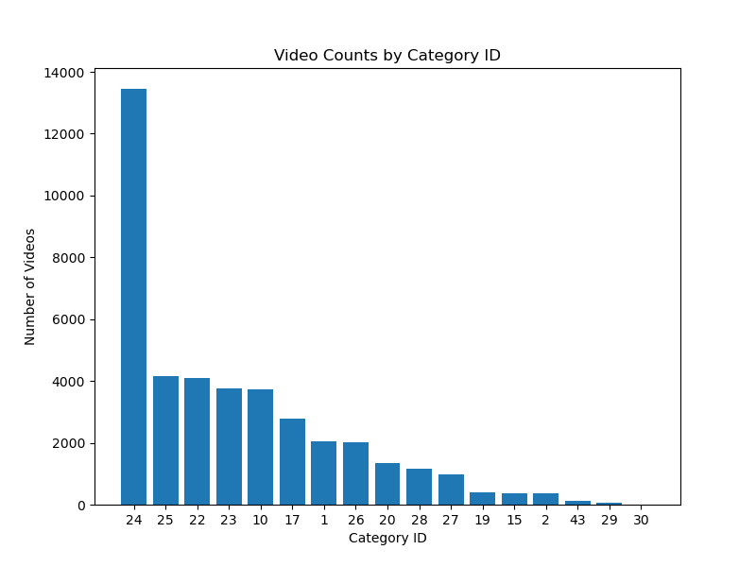
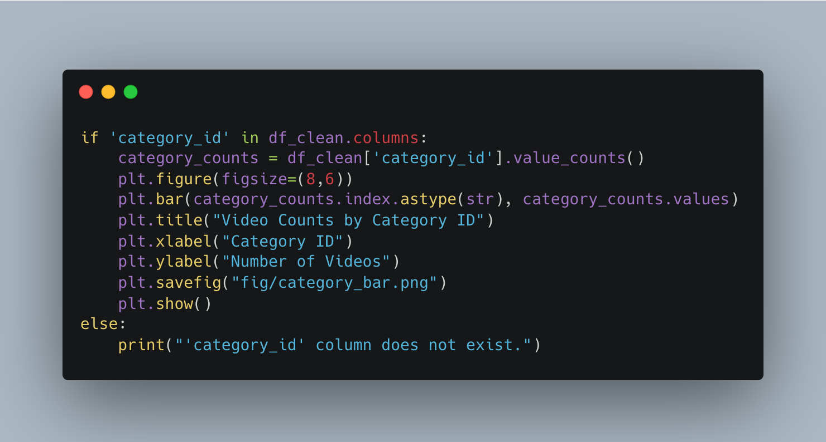
Step 7 — Category Bar Chart

Slide 12
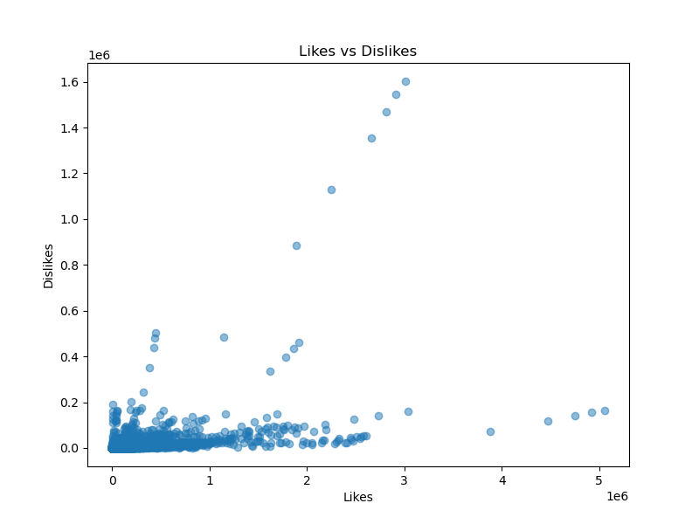
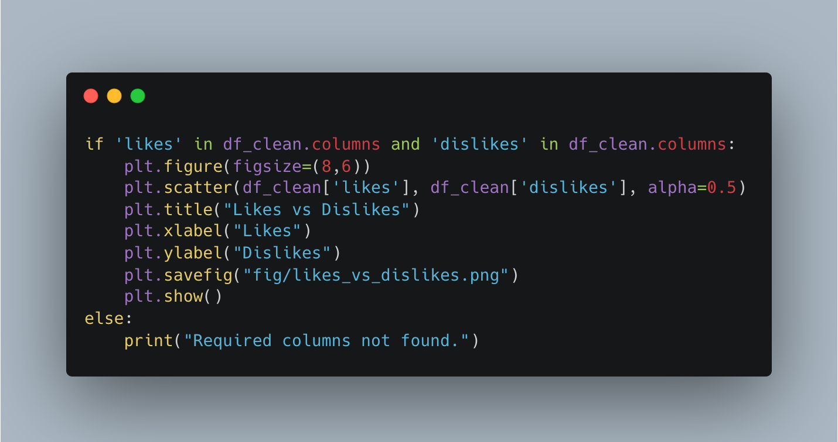
Step 8 — Likes vs Dislikes

Slide 13
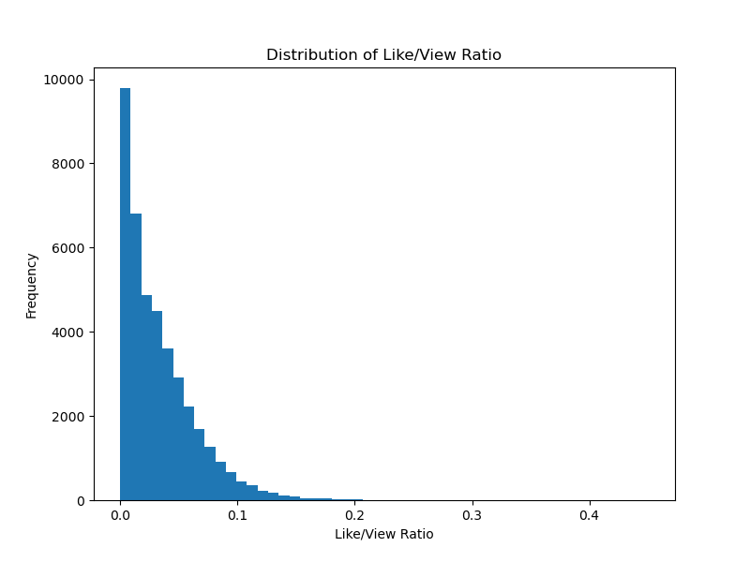
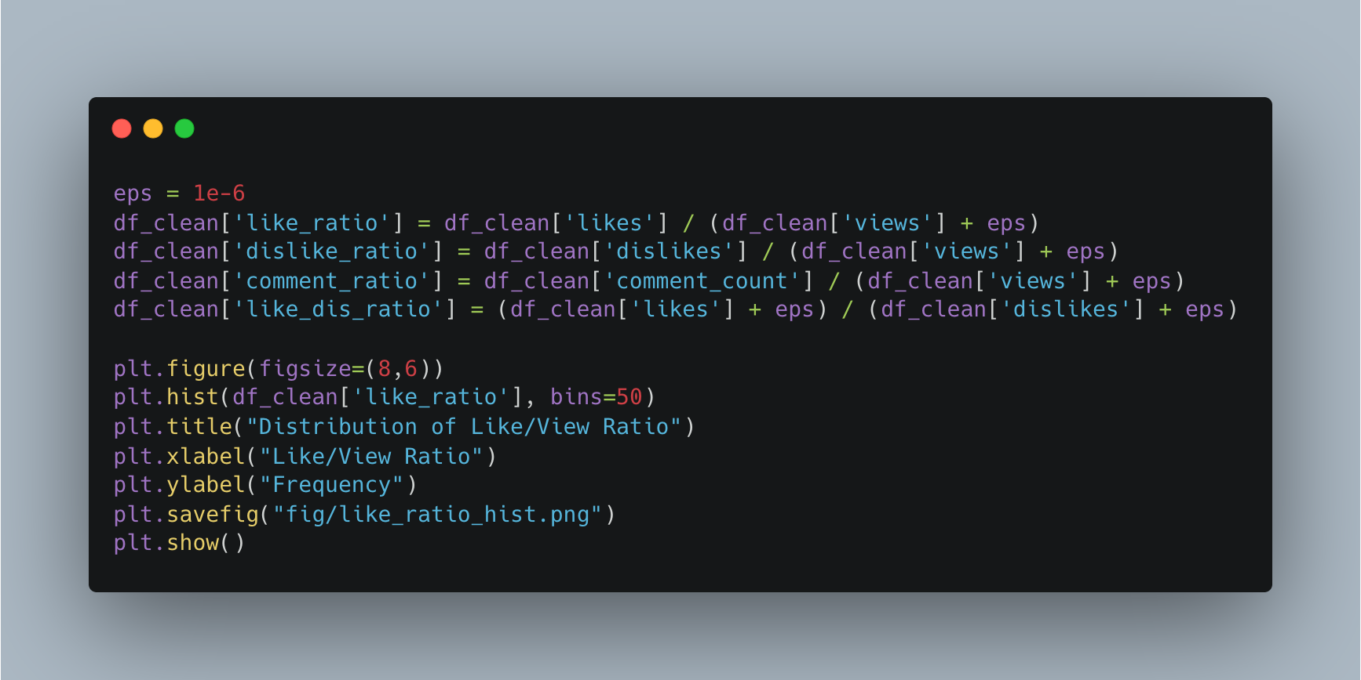
Step 9 — Engagement Ratios

Slide 14
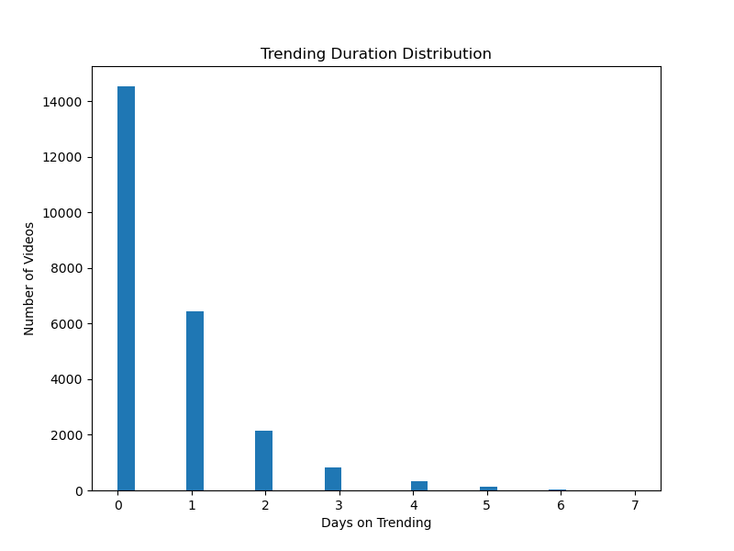
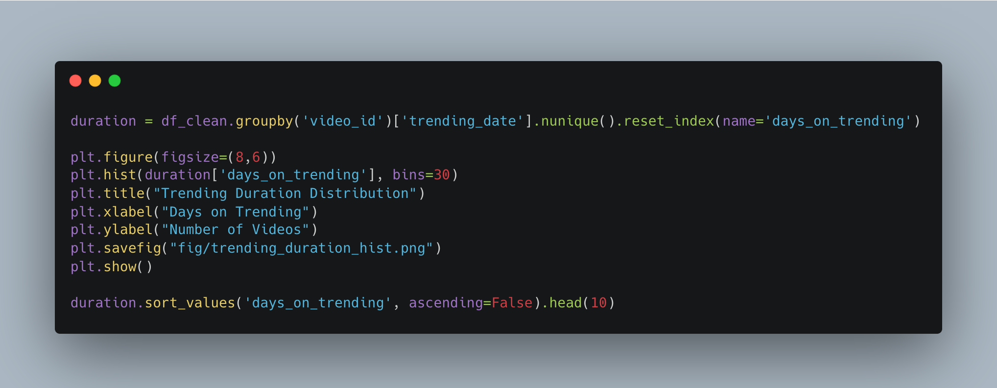
Step 10 — Trending Duration

Slide 15
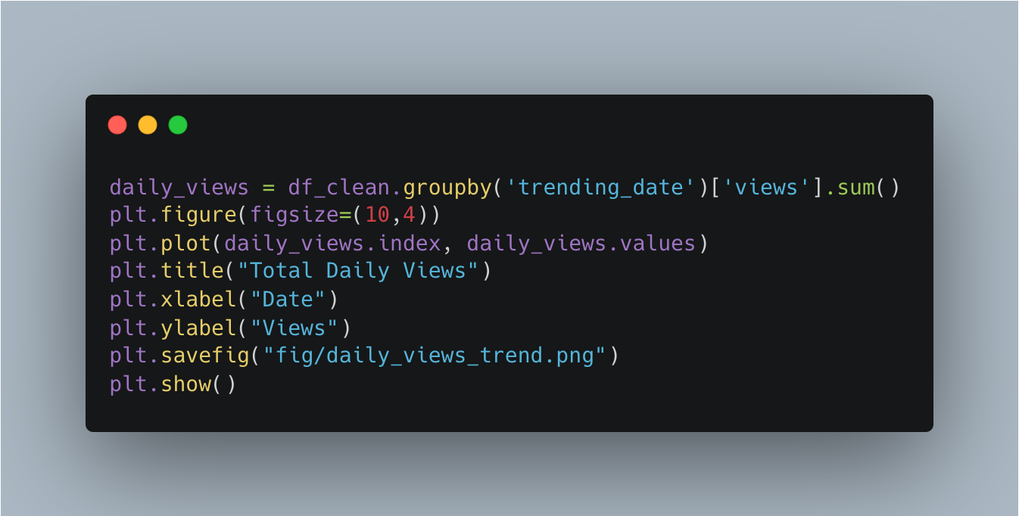
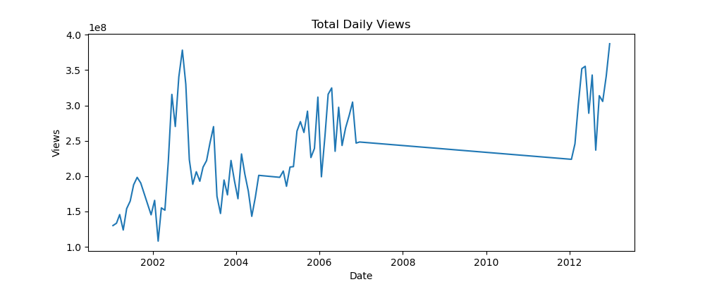
Step 11 — Daily Views

Slide 16
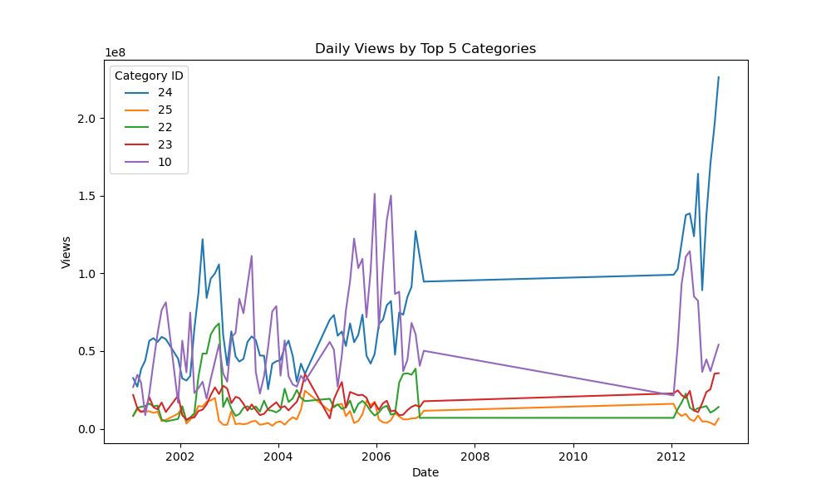
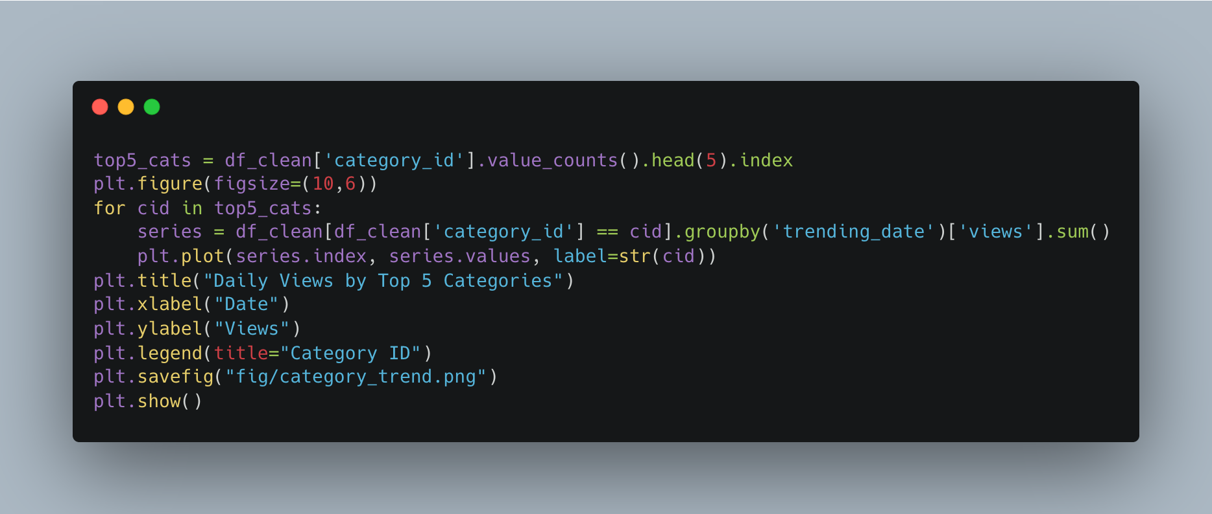
Step 12 — Top 5 Categories Trend

Slide 17
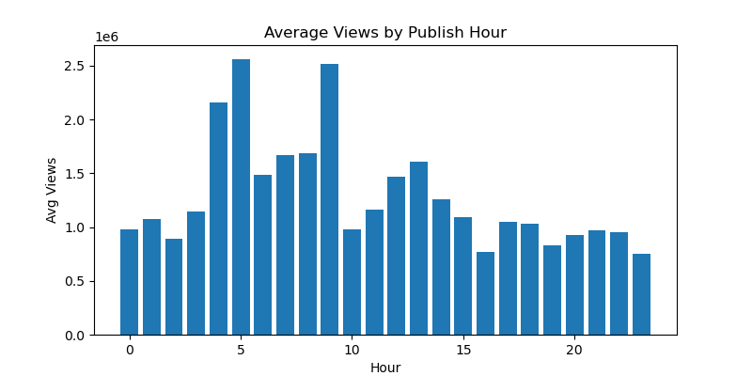
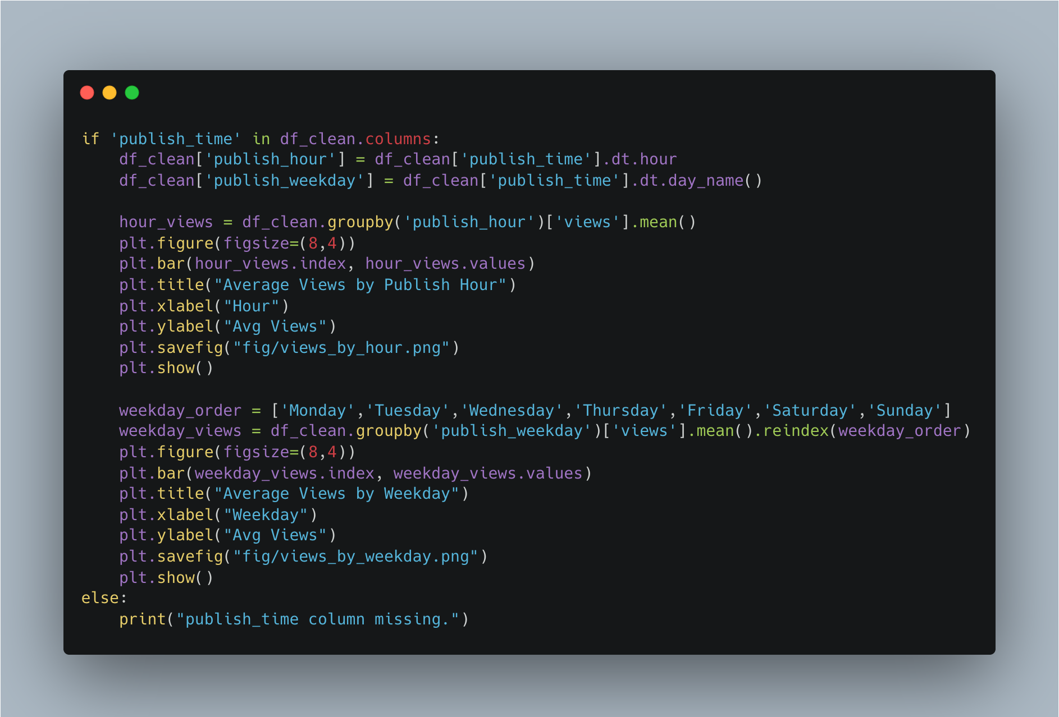
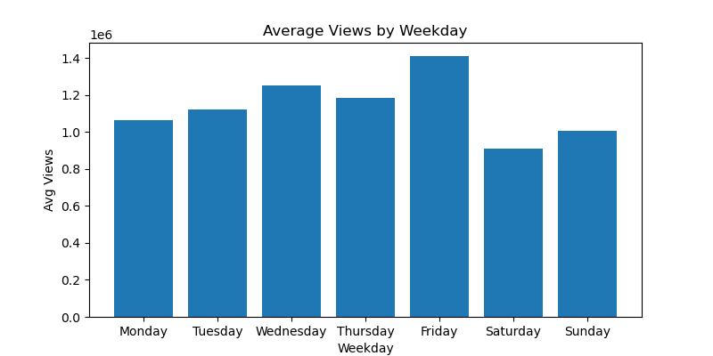
Step 13 — Publish Time Effect

Slide 18
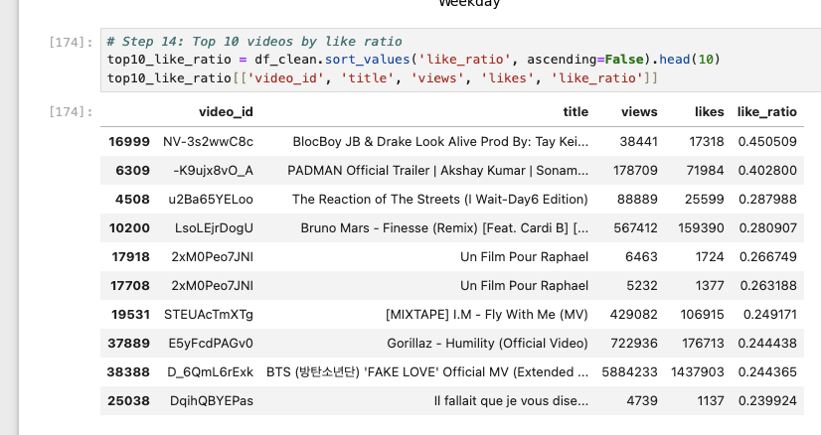
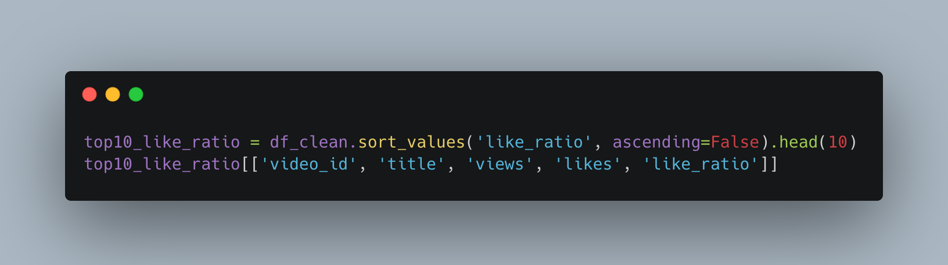
Step 14 — Top Like Ratio Videos

Slide 19
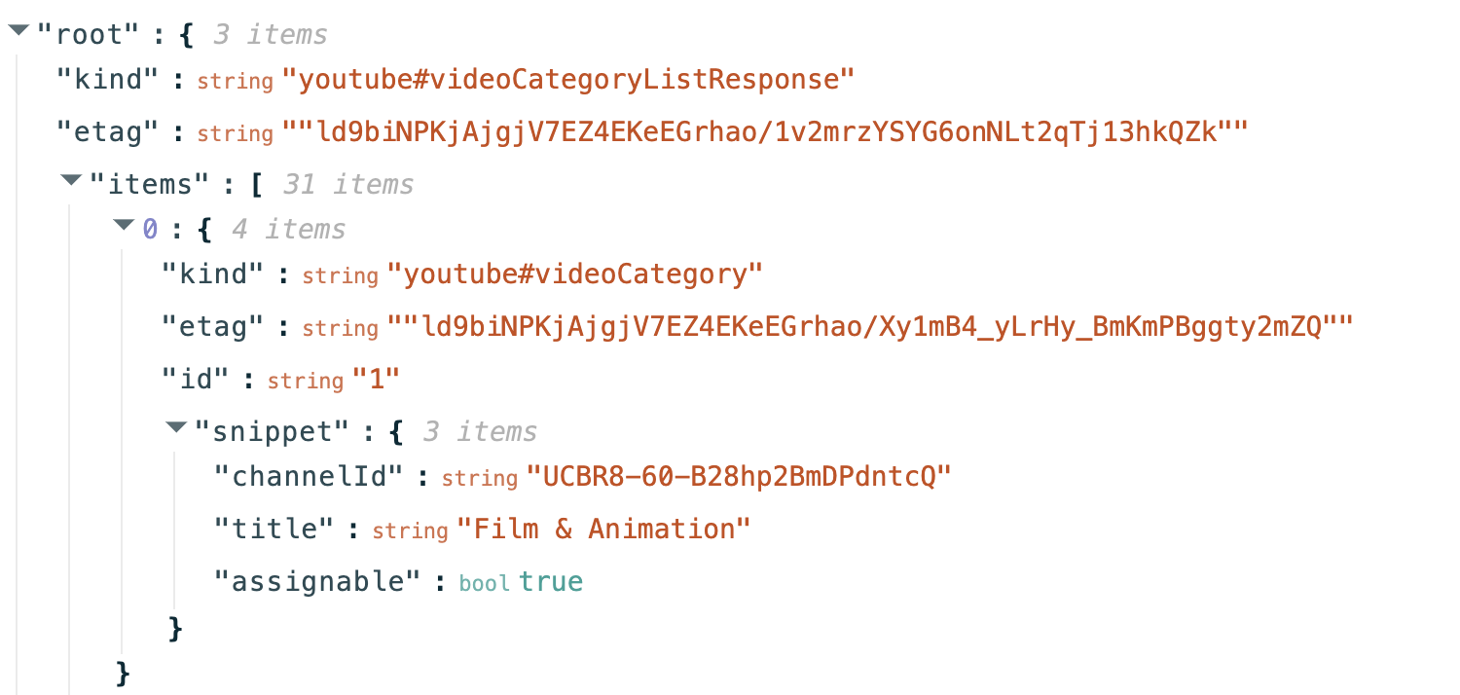
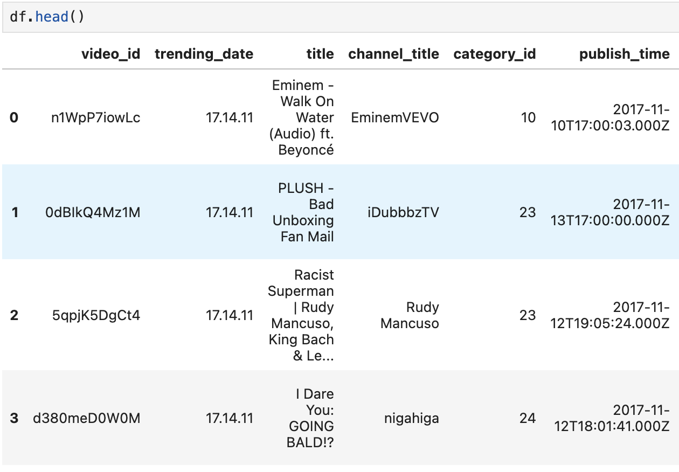
Data pre-processing
Map category name to dataset

Slide 20
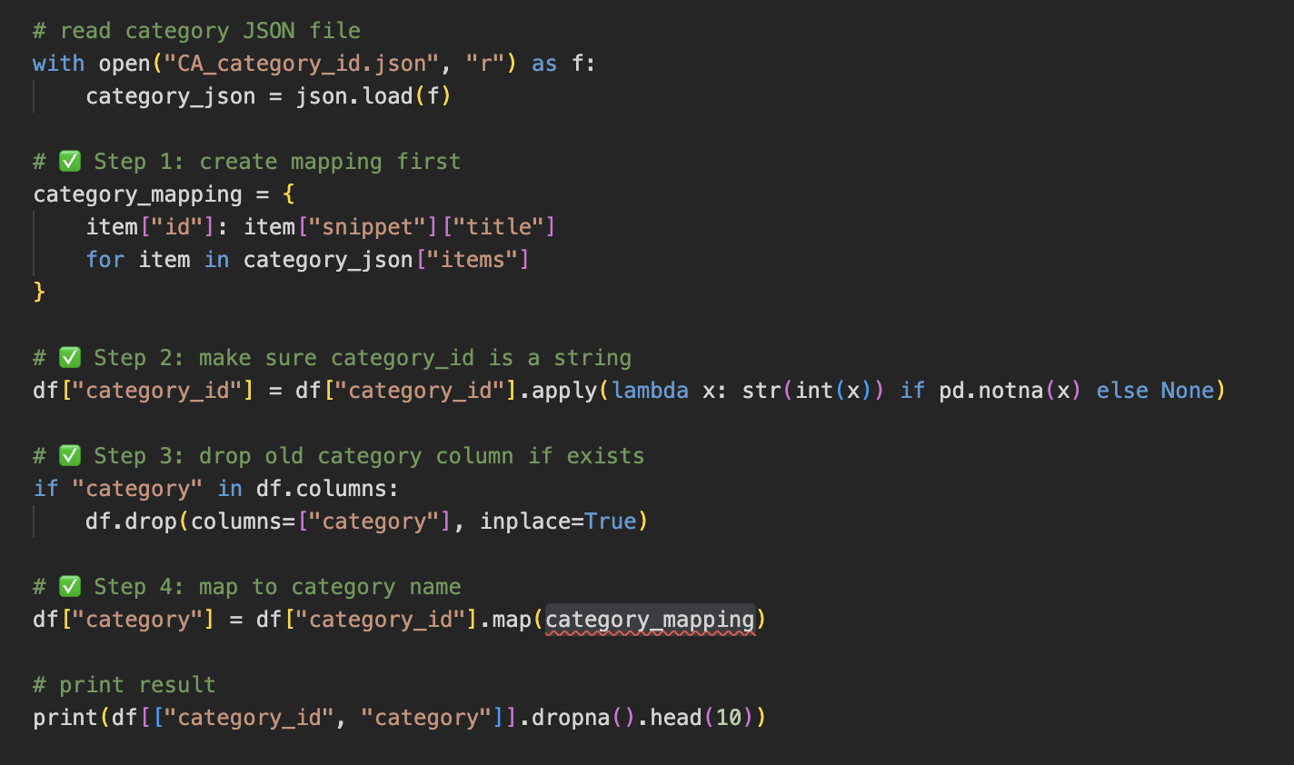
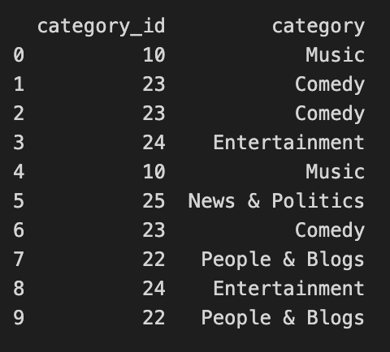
Data pre-processing
Map category name to dataset

Slide 21
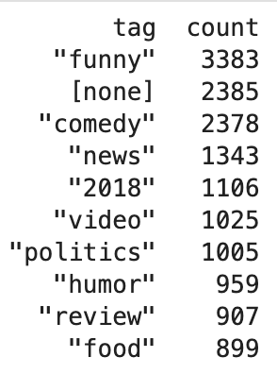
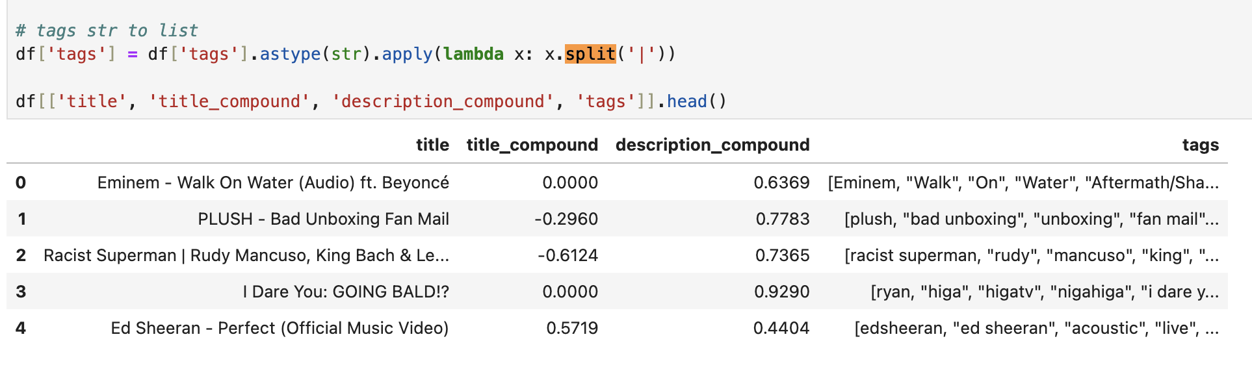
Data pre-processing
Split tags, convert str to list of str

Slide 22
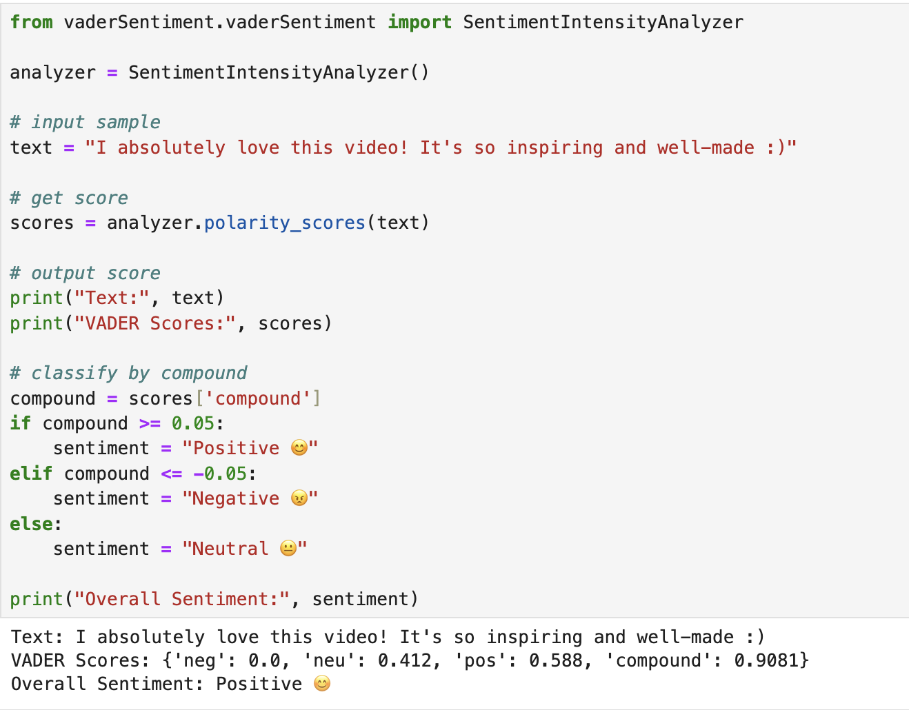
Add sentiment score of title/description
Vader Sentiment
It convert a sentence (strings) to 4 sentiment scores: neg, neu, pos and compound.
-1 <= compound <= 1

Slide 23
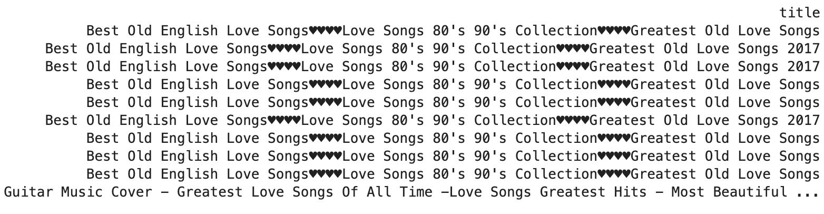
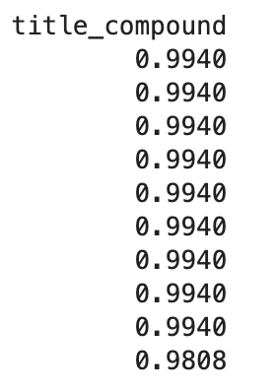
Add sentiment score of title/description
Top 10 Positive Title Sentiments:

Slide 24
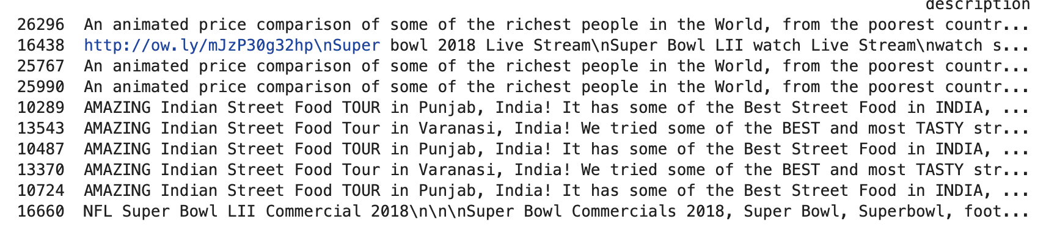
Add sentiment score of title/description
Top 10 Positive Descripition Sentiments:

Slide 25
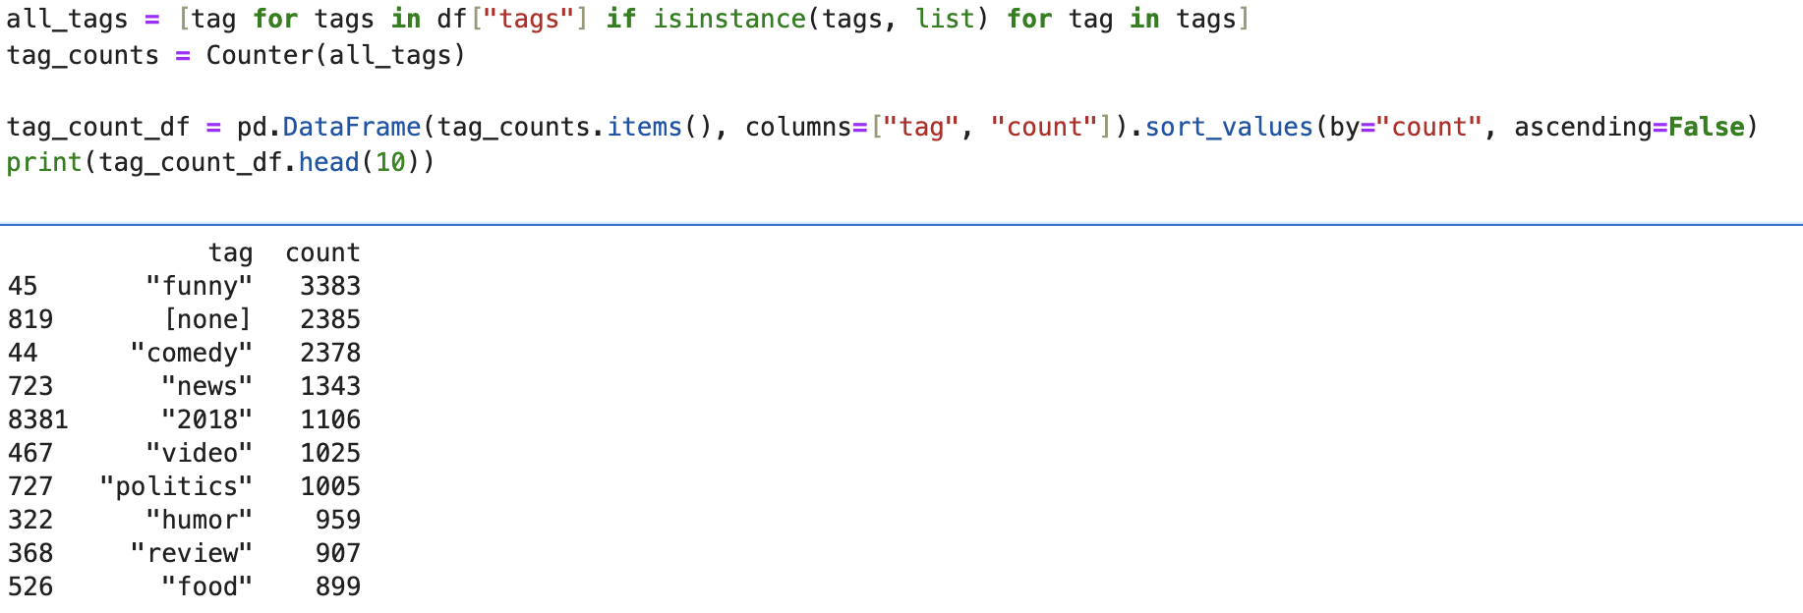
Basic EDA
Tags count

Slide 26
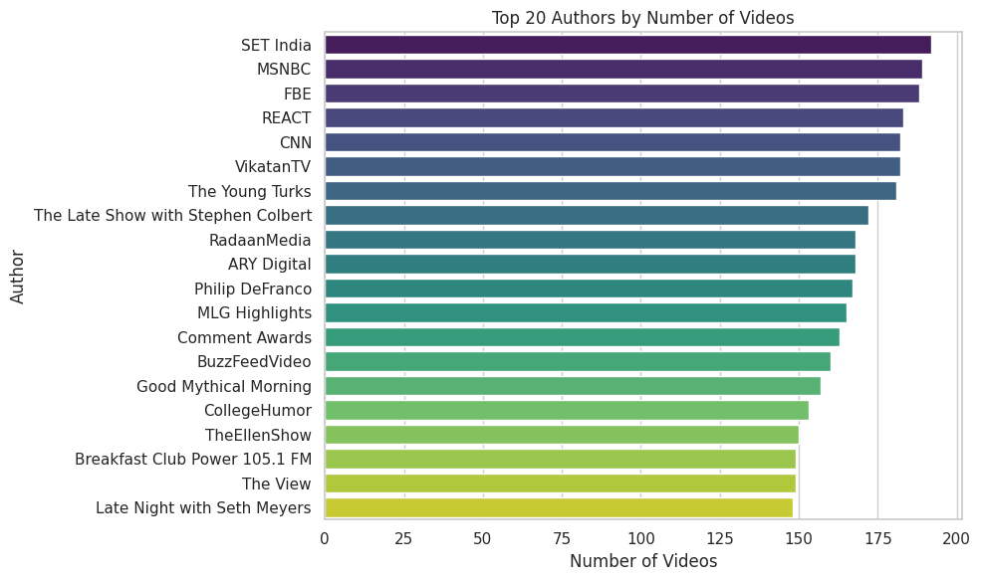
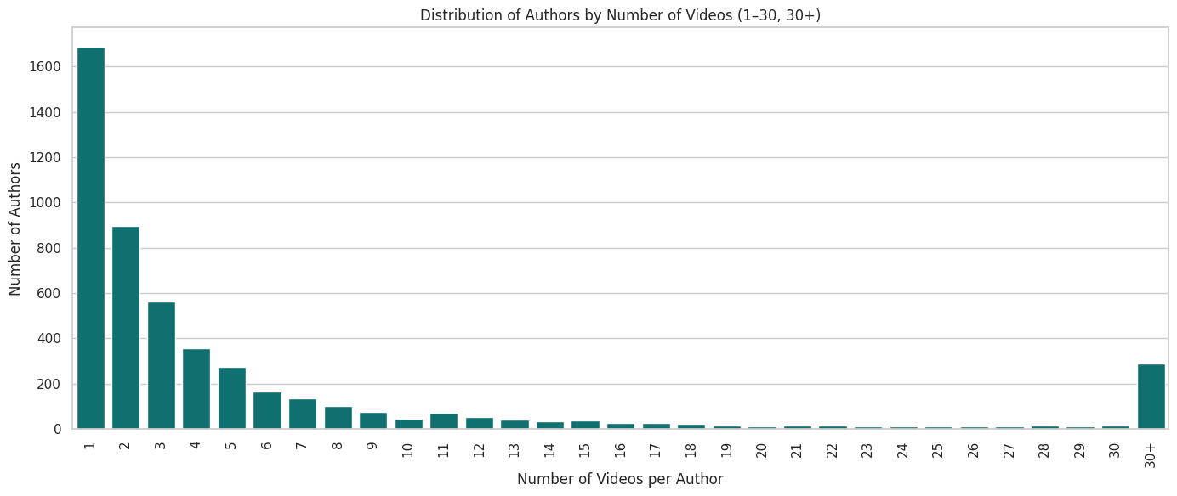
Basic EDA

Slide 27
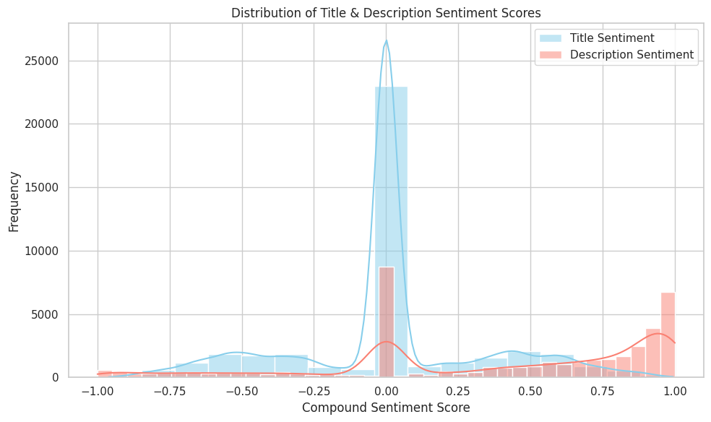
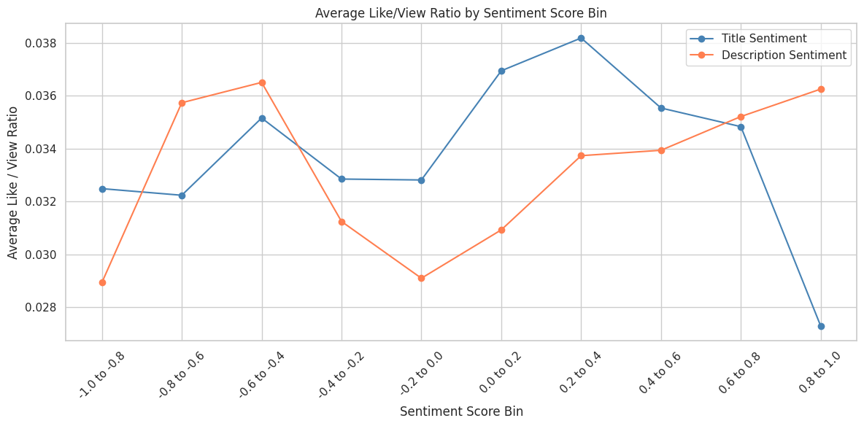
Basic EDA
Notes:
We found that videos with neutral titles and descriptions are the most common, but they tend to have a lower likes-to-views ratio. In contrast, videos with relatively positive or negative tones receive more likes per view on average.

Slide 28
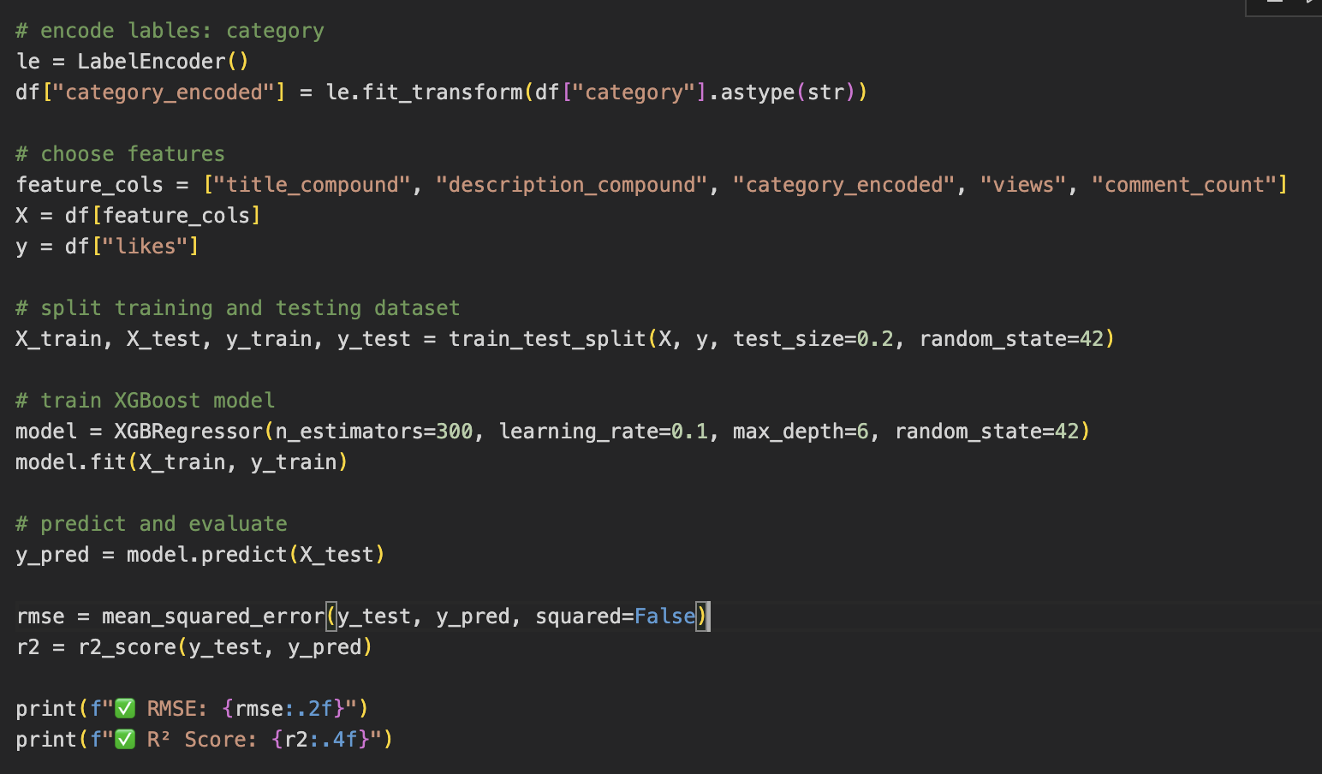
Predictive Model: Number of likes
Use Xgboost model, title_compound+description_compound+views+category_id
To predict number of likes

Slide 29
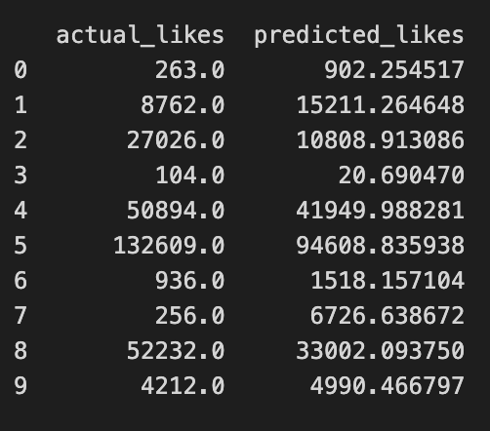
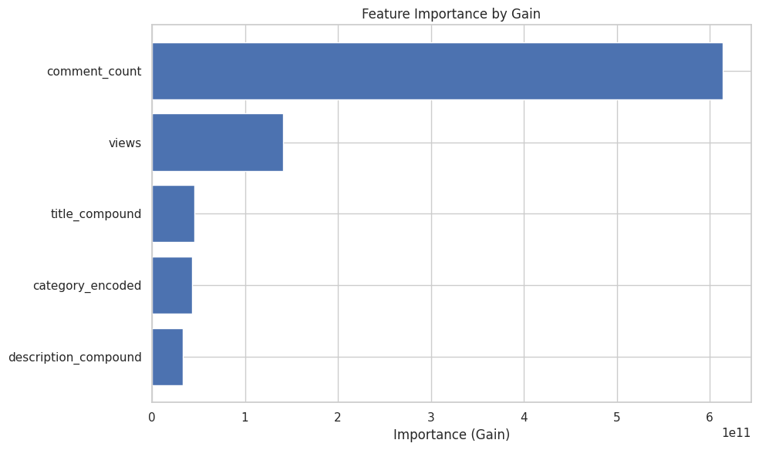
Predictive Model: Number of likes

Slide 30
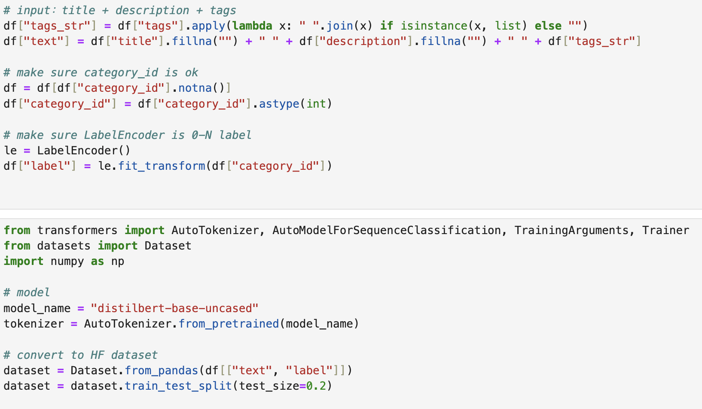
Predictive Model: category
571 × 300
Use title+description+tags to predict category
Encoder: distilled bert

Slide 31
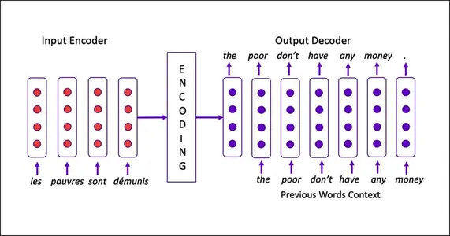
Predictive Model: category

Slide 32
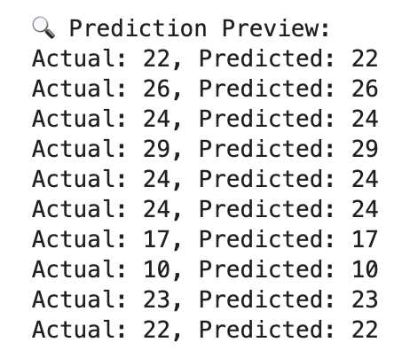
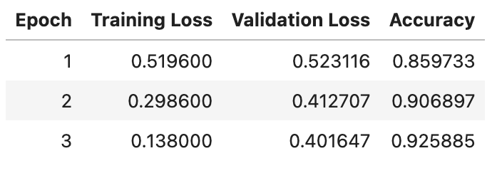
Predictive Model: category

Slide 33

Azure

Slide 34


Bronze

Slide 35
Silver

Slide 36

Gold

Slide 37

Power BI

Slide 38

Power BI

Slide 39

Power BI
Sum of Views by Month
Month

Slide 40

Power BI
Sum of likes by Month
Month

Slide 41

Power BI
Average of title-compound by Month
Month

